Slide 1
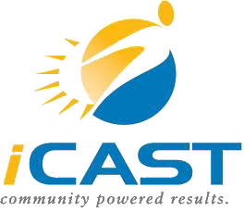
International Center for Appropriate and Sustainable Technology
Using Local Resources for Local Benefit

Slide 2
iCAST Mission
To provide economic, environmental, and social benefits to communities in a way that builds local capacity
Environmental Stewardship
Social Responsibility
Economic Development

Slide 3
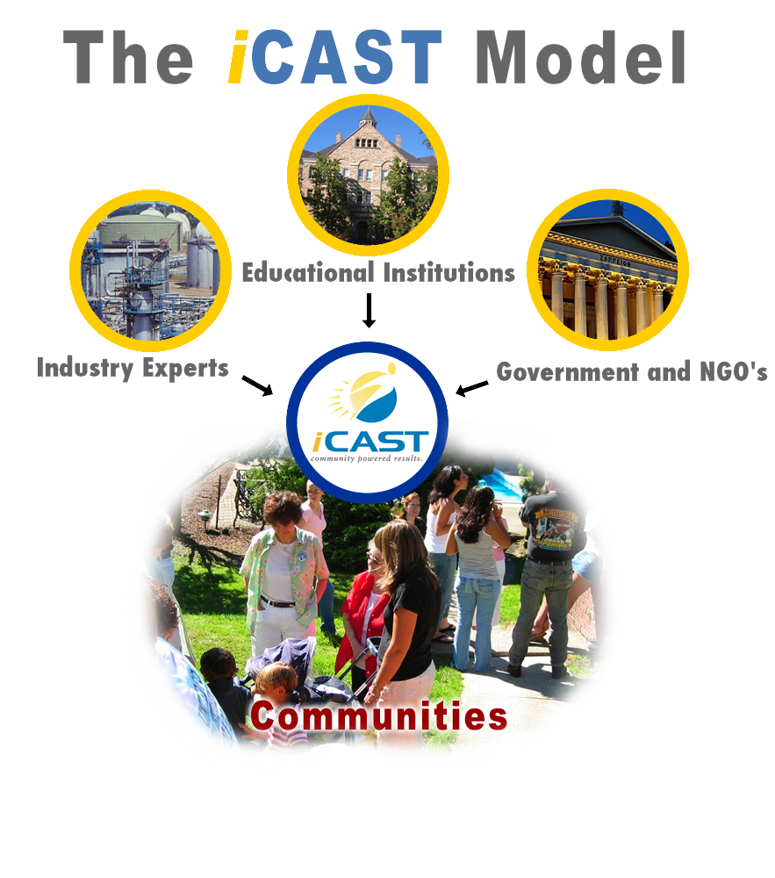

Slide 4
Service Learning
Partnership with Educational Institutions
Faculty supervision
Industry Mentors
Students – class projects, independent study, internship
Assist with community projects
Problem definition – SWOT analysis
Research optimal solutions – Decision analysis
Assist with implementation
Gain real-life experiences
Gain real-life experience
Build skills in: Teamwork, Communications, Leadership, Management

Slide 5
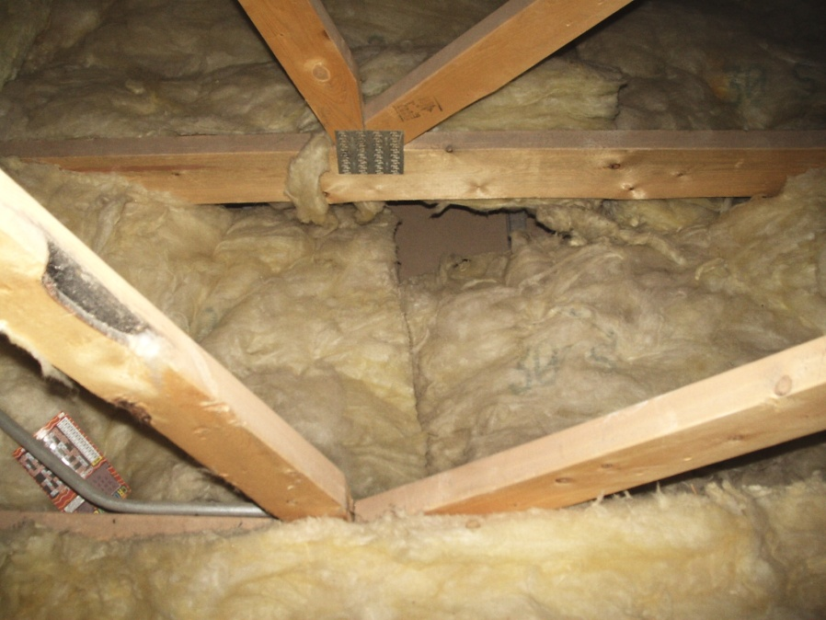
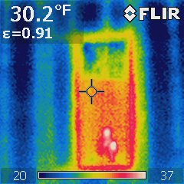
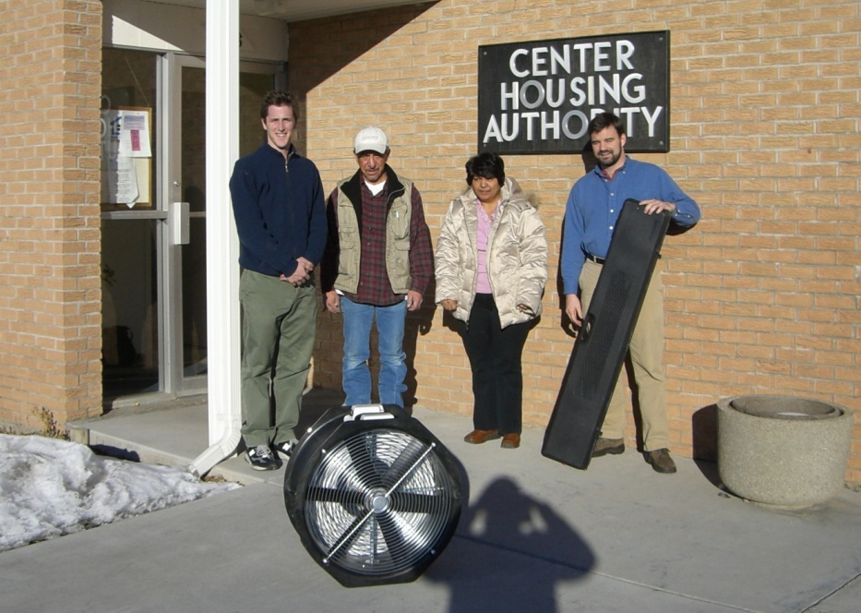
Energy Efficiency
Residential
Commercial
Training
Turn-Key Services

Slide 6
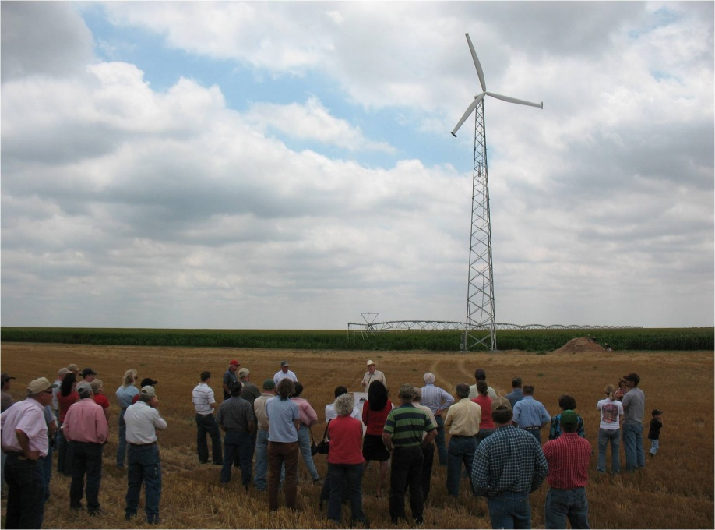
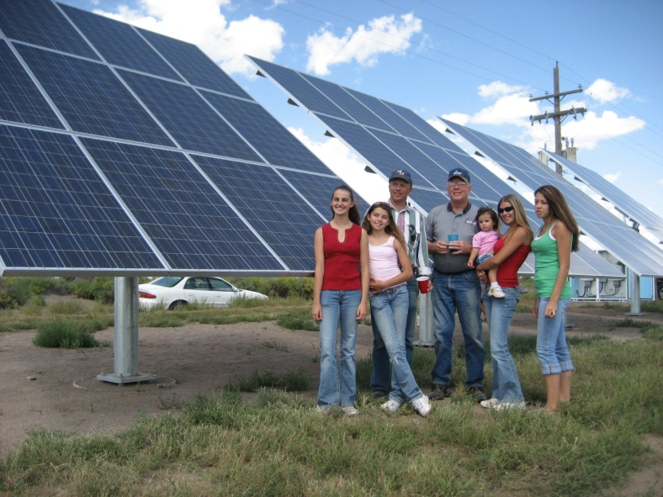
Renewable Energy
Wind
Solar PV and Thermal
Hydro
Geothermal
Energy Storage
Training

Slide 7
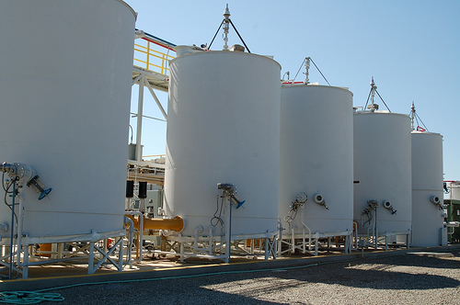


Sustainable Agriculture
Value-Added Processing
Sustainable Forestry
Animal Husbandry

Slide 8

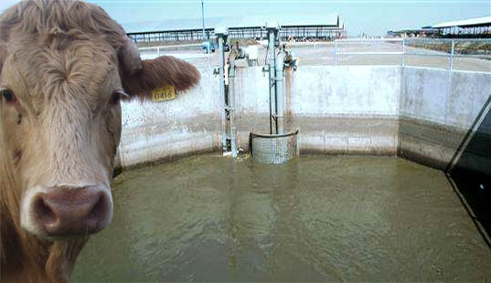
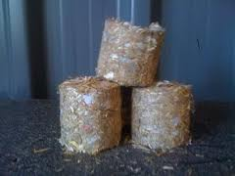
Waste Utilization
Coal Ash
Agricultural residues
Forestry waste
Animal Waste

Slide 9
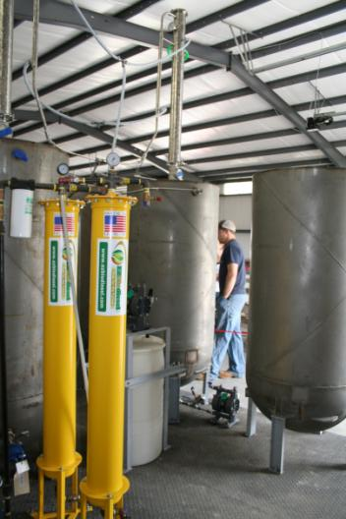
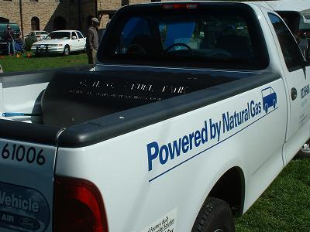
Transportation
CNG Vehicles
Biodiesel
EV infrastructure

Slide 10
Accomplishments
Promoted the launch of eight for-profit start-ups and advised dozens of small businesses
Facilitated the creation of hundreds of jobs in Colorado
Enabled economic impact worth over $200 Million;
Each Year:
Save over 7 Million kWh of energy
Reduced CO₂ emissions by 5 Million lbs
Engaged 150+ university students in community projects
Served 1,000+ low income households, non-profits, etc.
Provided direct economic impetus worth over $5M

Slide 11
International Center for Appropriate and Sustainable Technology
Social Entrepreneurship

Slide 12
References
Panchavati, Shyamsunder, “Social Entrepreneurship.” Powerpoint presentation.
“Social Entrepreneurship and Changemaking.” Powerpoint presentation, Ashoka.
“An Introduction to Social Entrepreneurship.” Powerpoint presentation, Syracuse University.
“Community Economic Development A Guide to Choosing the Appropriate Economic Development Model for Your Community.” Powerpoint presentation, iCAST.
“Social Entrepreneurship 101.” Powerpoint presentation, Friends of Ebonie, 2012.
Lux, S., “Social Entrepreneurship: International Perspectives.” Powerpoint presentation, Maxwell School of Syracuse University.
LePage, D., “The Why and How of Social Enterprise.” Powerpoint presentation, Enterprising Non-Profits.
Russell, R., “Social Entrepreneurship.” Powerpoint presentation, RDU.
Shrestha, S., Dev Appanah, S., “Social Enterprise Plan: The Guide.” Powerpoint presentation.
Tsai, C., “The 6 Habits of Highly Effective Social Entrepreneurs.” Powerpoint presentation, Social Creatives.

